Slide 1
Model View Controller (MVC)

Slide 2

Objectives
At the end of this session, you will be able to,
Describe MVC Architecture

Slide 3

Agenda
Following topics is to be covered in the session
MVC Architecture

Slide 4
MVC Architecture
Model-View-Controller (MVC) is an architectural pattern used in software engineering.
Successful use of the pattern isolates business logic from user interface considerations, resulting in an application where it is easier to modify either the visual appearance of the application or the underlying business rules without affecting the other.
It is common to split an application into separate layers: presentation (UI), domain logic, and data access.
In MVC the presentation layer is further separated into view and controller.
MVC encompasses more of the architecture of an application than is typical for a design pattern.

Slide 5
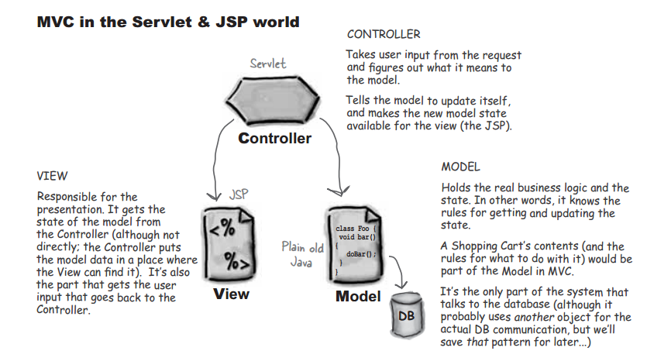
MVC Concept..

Slide 6
MVC Architecture
Model - View - Controller
Model
Query the model State
Invokes Methods in the Model’s API
Notify View of Change in Model State
View
Controller
Select View
Users Actions/Commands

Slide 7
MVC Architecture
Model
Represents an application’s data and contains the logic for accessing and manipulating that data.
Any data that is part of the persistent state of the application should reside in the model objects.
Domain logic adds meaning to raw data (e.g. calculating if today is the user's birthday, or the totals, taxes, and shipping charges for shopping cart items).
Many applications use a persistent storage mechanism (such as a database) to store data. MVC does not specifically mention the data access layer because it is understood to be underneath or encapsulated by the Model.

Slide 8
MVC Architecture
View
Is responsible for rendering the state of the model.
The presentation semantics are encapsulated within the view, therefore model data can be adapted for several different kinds of clients.
The view modifies itself when a change in the model is communicated to the view.
A view forwards user input to the controller.
Multiple views can exist for a single model for different purposes.

Slide 9
MVC Architecture
Controller
Is responsible for intercepting and translating user input into actions to be performed by the model.
Is responsible for selecting the next view based on user input and the outcome of model operations.
Processes and responds to events, typically user actions, and may invoke changes on the model.
MVC is often seen in web applications, where the view is the actual HTML page, and the controller is the code that gathers dynamic data and generates the content within the HTML. Finally, the model is represented by the actual content, usually stored in a database or XML files, and the business rules that transform that content based on user actions.

Slide 10
MVC Architecture
Though MVC comes in different flavors, control flow generally works as follows:
The user interacts with the user interface in some way (e.g. presses a button).
A controller handles the input event from the user interface, often via a registered handler or callback.
The controller notifies the model of the user action, possibly resulting in a change in the model's state. (e.g. controller updates user's Shopping cart).
A view uses the model (indirectly) to generate an appropriate user interface (e.g. the view produces a screen listing the shopping cart contents). The view gets its own data from the model. The model has no direct knowledge of the view.
The user interface waits for further user interactions, which begins the cycle anew.

Slide 11
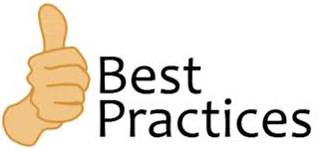
Best Practices : Due to various advantages of MVC, it is recommended to use it in developing web applications. Because of MVC, code becomes maintainable and simplified.
Also it is technology independent i.e. you can use it to create any application like desktop / Single Page Application (using Java Script, MEAN stack) / applications created using .Net framework.
Various Java frameworks are based on MVC. Like Struts , Spring etc.
So always use MVC while creating web application.

Slide 12

Knowledge check…
Who is ideally responsible for following tasks according to MVC : JSP / Java Beans / Servlet ?
No | Task | JSP | Java Bean | Servlet
1 | Form designing
2 | Communicating to DB
3 | Receiving user request data
4 | Displaying output /result to user
5 | Controlling the flow in application
6 | Server side validations
Notes:
Ans:
JSP
Java Beans
Servlet
JSP
Servlet
Java Beans

Slide 13

Summary
In this session, we have covered,
MVC Architecture

Slide 14
Thank You

